Slide 1
Property Price Prediction
(using Linear Regression Model)
IMARTICUS PGDA BATCH_29
Under Guidance of:
Dr. Vinod Steve
Presented by:
Team X̄

Slide 2
Abstract
• Real estate in the least transparent industry in our ecosystem.
• House prices increase every year, so there is a need for a system to predict
house prices in the future.
• Predicting House Prices with real factors.
• We aim to make evaluations based on every basic parameter that is
considered while determining the price

Slide 3
Methodology
Cleaning Data by removing null values and replacing the null values with mode for categorical data and median/mean for continuous data
Reducing Continuous attribute by checking the correlation of each continuous variable with target variable and validating it with linear-regression plot
Analysing Categorical data with highest correlating continuous variable by grouping it with various levels of category
Cleaning Outliers by Plotting Box plot and replacing it with median
Randomly Selecting Attributes
Number of levels =2

Slide 4
Methodology
Number of levels =2
Yes
No
Independency Test
ANOVA
Test
Yes
P_Value> 0.05
No
Yes
P_Value> 0.05
No
Two levels are same, hence Drop the attribute
Two levels are different, hence we keep the attribute
Multi levels are same, hence we Drop the attribute
At Least one is different, hence we perform Tukey Test

Slide 5
Methodology
Yes
Reduce/Replace any one group by either of the names
Reducing the Multi levels of each Category with the help of Tukey plot by seeing how close the mean values are with each other
P_Value> 0.05
At Least one is different, hence we perform Tukey Test
Linear Regression Model
No
No Reduction Required
Validating the Four Assumptions for Linear Regression Model
Multicollinearity Test
Autocorrelation Test
Insights
Final Statement/verdict

Slide 6
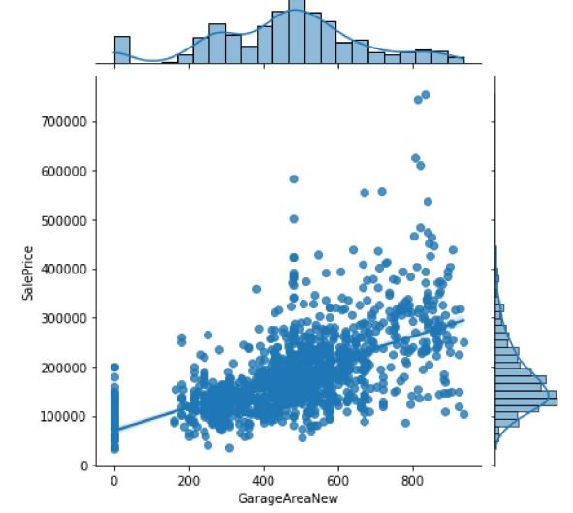
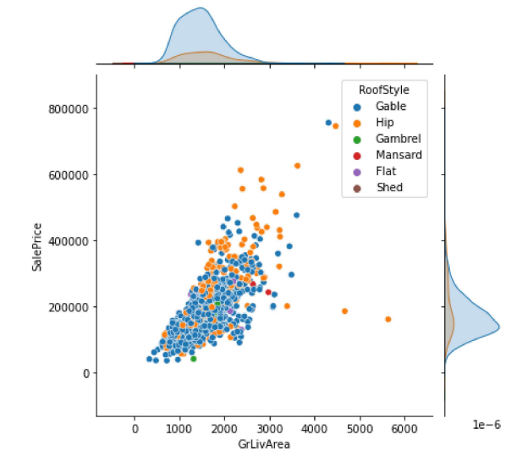
Visualizing Continuous and Categorical Data
SalePrice vs GrageArea
SalePrice vs GrageArea with Hue RoofStyle

Slide 7
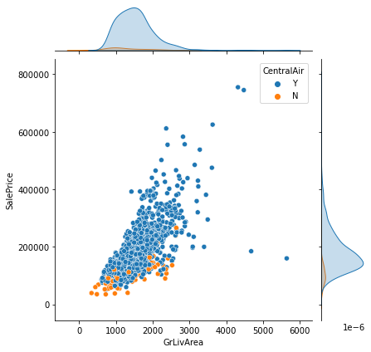
Independent T Test
pvalue=1.8095061559266025e-22
Since the p-value is less the 0.05, we reject the null hypothesis.
Null Hypothesis: Avg Sale Price of Property with Central AC = Avg Sale Price of Property without Central AC
Alternate Hypothesis: Avg Sale Price of Property with Central AC != Avg Sale Price of Property without Central AC

Slide 8
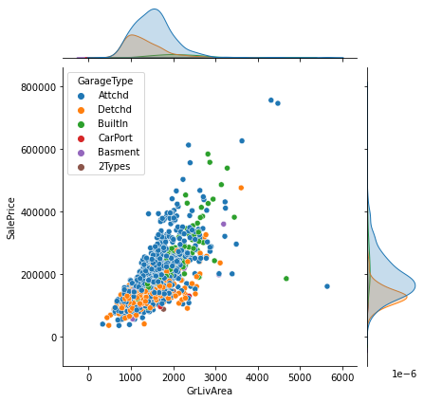
ANOVA
pvalue=2.578443e-56
Since the p-value is less the 0.05, we reject the null hypothesis.
Null Hypothesis: Avg Sale Price of Property is same across all the categories
Alternate Hypothesis: Atleast one category’s Avg Sale Price of Property is different

Slide 9
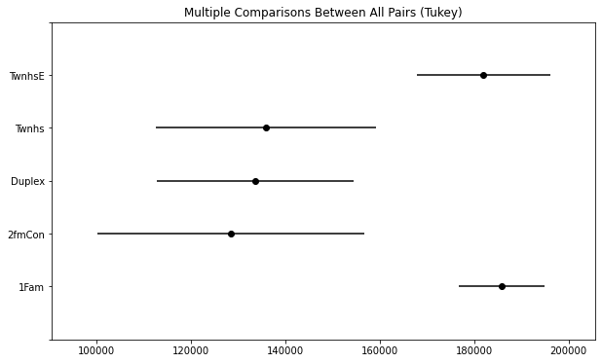
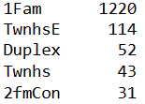

ANOVA and Tukey Plot
Before Reduction of Levels
After Reduction of Levels
*We have used ANOVA and Tukey HSD to reduce the no. of variables or levels of all categorical variable wherever the mean sale price of property were statistically equal

Slide 10
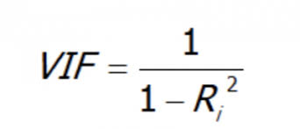
Multicollinearity
Technically if 2 of the independent variables are correlated we have collinearity.
But when 3 or more independent variables are correlated we have multicollinearity.
The problem with multicollinearity arise when intercorrelation between the independent variables is high. This will causes many problems with interpretations of the analysis
There is one technique called VIF(variance inflation factor) which will help to control multicollinearity.
Using VIF it is possible to determine whether any of the independent variable are function of other independent variable
If VIF >10 (then multicollinearity exists)

Slide 11
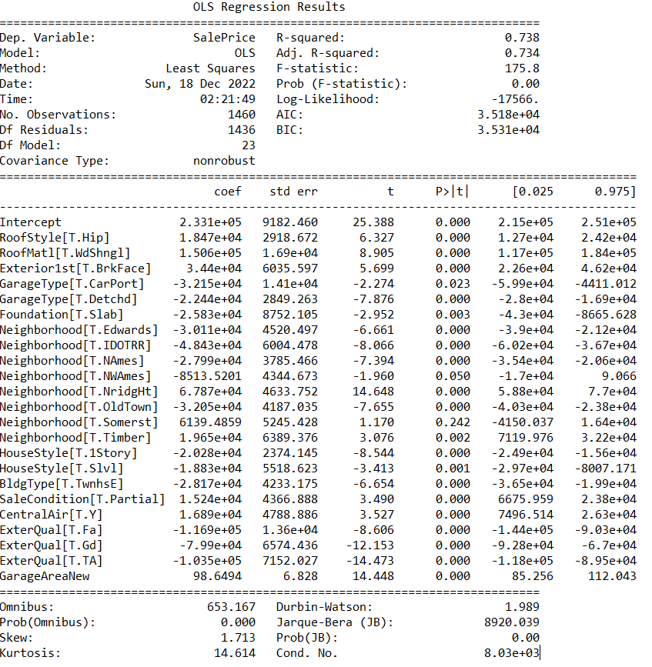
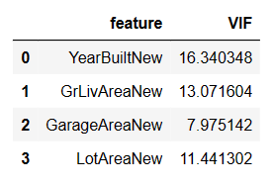

Slide 12
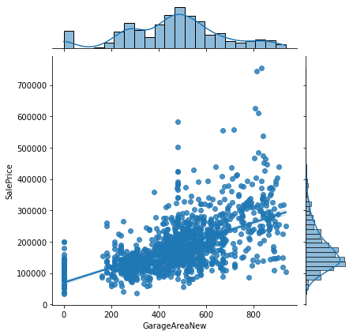
Model Linearity Test

Slide 13
Autocorrelation
Autocorrelation occurs when the error terms of the regression model are correlated.
Autocorrelation can be a problem in the regression analysis because it violates one of the assumptions of regression model (ie.Error terms are independent (not correlated)).
One way to determine whether autocorrelation is present in a regression is by using the Durbin-Watson test for autocorrelation.
It will test whether the residuals are independent or not.
Ho= There is no autocorrelation
Ha= There is autocorrelation
If D<dL (Ho is rejected)
If D>dU (Ho is accepted)

Slide 14
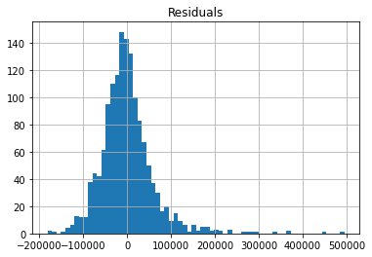
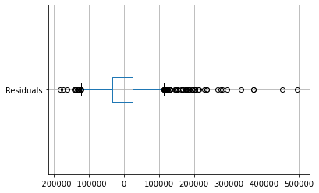
Normality of Residuals Test
The mean is almost in the centre, hence it is approximately Normally Distributed curve

Slide 15
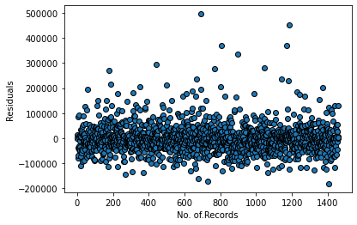
Model Independency Test
As the residuals are distributed randomly around the mean, and they don’t form any geometrical pattern, hence Error Terms are independent, so there is no biased ness

Slide 16
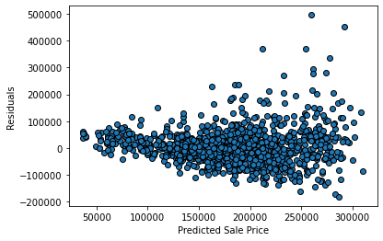
Homoscedasticity Test
The Variance in the upper part and the lower part are almost identical, hence there is no heteroscedasticity

Slide 17
Regression Model
Sale Price = 233100 + 98.64*Garage Area
R- Square = 0.738 / Coefficient of Determination / 73.8% variance in Sale Price of Homes can be explained by Garage Area with categorical features like Roof Style, Roof Material, Exterior, Garage Type, Foundation, Neighbourhood, House Style, Building Type, Sale Condition, Central Air Conditioning, Exterior Quality
Null Hypothesis: Model is not good
Alternate Hypothesis: Model is good
P-value = 0.00. Since p-value is less than 0.05 so reject Null Hypothesis, which means the model is good
Durbin - Watson = 1.989. Since the value is close to 2, there is no autocorrelation in the model.

Slide 18
On an average sale price of property with Roof style “Hip” is more by $18,470 as compared to “Gable”
On an average sale price of property with Roof Material “WdShngl” is more by $1,50,600 as compared to “CompShg”
On an average sale price of property with Exterior1st “BrkFace” is more by $34,400 as compared to “AsbShng”
On an average sale price of property with Garage Type “CarPort” is less by $32,150 as compared to “Attchd”
On an average sale price of property with Garage Type “Detchd” is less by $22,440 as compared to “Attchd”

Slide 19
On an average sale price of property with Foundation “Slab” is less by $25,830 as compared to “BrkTil”
On an average sale price of property with Neighborhood “Edwards” is less by $30,110 as compared to “Collgcr”
On an average sale price of property with Neighborhood “IDOTRR” is less by $48,430 as compared to “Collgcr”
On an average sale price of property with Neighborhood “NAmes” is less by $27,990 as compared to “Collgcr”
On an average sale price of property with Neighborhood “NWAmes” is less by $8513.52 as compared to “Collgcr”

Slide 20
On an average sale price of property with Neighborhood “NridgHT” is more by $67,870 as compared to “Collgcr”
On an average sale price of property with Neighborhood “OldTown” is less by $32,050 as compared to “Collgcr”
On an average sale price of property with Neighborhood “Timber” is more by $19,650 as compared to “Collgcr”

Slide 21
On an average sale price of property with Central Air Conditioning is more by $16,890 as compared to “Non- Central” “Air-conditioned Property”
On an average sale price of property with Sale Condition “Partial” is more by $15,240 as compared to “Normal” Sale Condition”
On an average sale price of property with “1 Family” Building Type is less by $28,170 as compared to “Townhouse Building Type”
On an average sale price of property with “Slvl” House Style is less by $18,830 as compared to “1.5Fin” House Style
On an average sale price of property with “1Storey” House Style is less by $20,280 as compared to “1.5Fin” House Style

Slide 22
1sqft change in “Garage Area” will result in 98.6494 times change in “Property Sale Price”
On an average sale price of property with External Quality “TA” is less by $1,03,500 as compared to “Ex” External Quality
On an average sale price of property with External Quality “Gd” is less by $79,900 as compared to “Ex” External Quality
On an average sale price of property with External Quality “Fa” is less by $1,16,900 as compared to “Ex” External Quality

